Slide 1
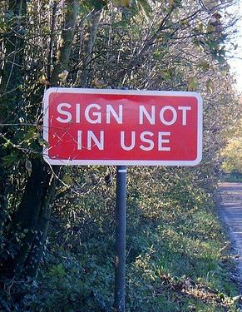
The Twitter Paradox
Is social media a genuine reflection of society OR a Funhouse mirror?
By: Ivan Rodriguez
Data Analytics
Ironhack Miami

Slide 2
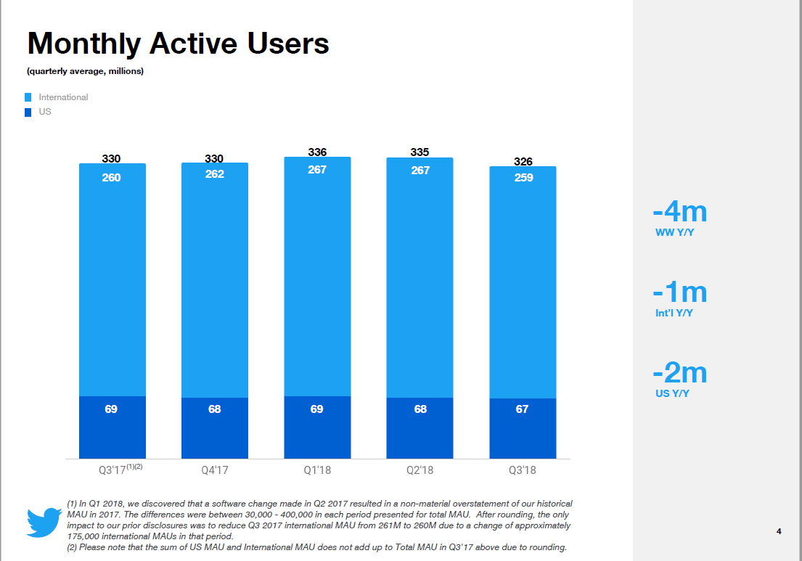
Twitter Quick Facts:
Twitter measures its users by monthly active users, or MAUs.
Twitter has 330 Million MAUs.
69 Million MAUs are in the US.
21% of US adults use Twitter.

Slide 3
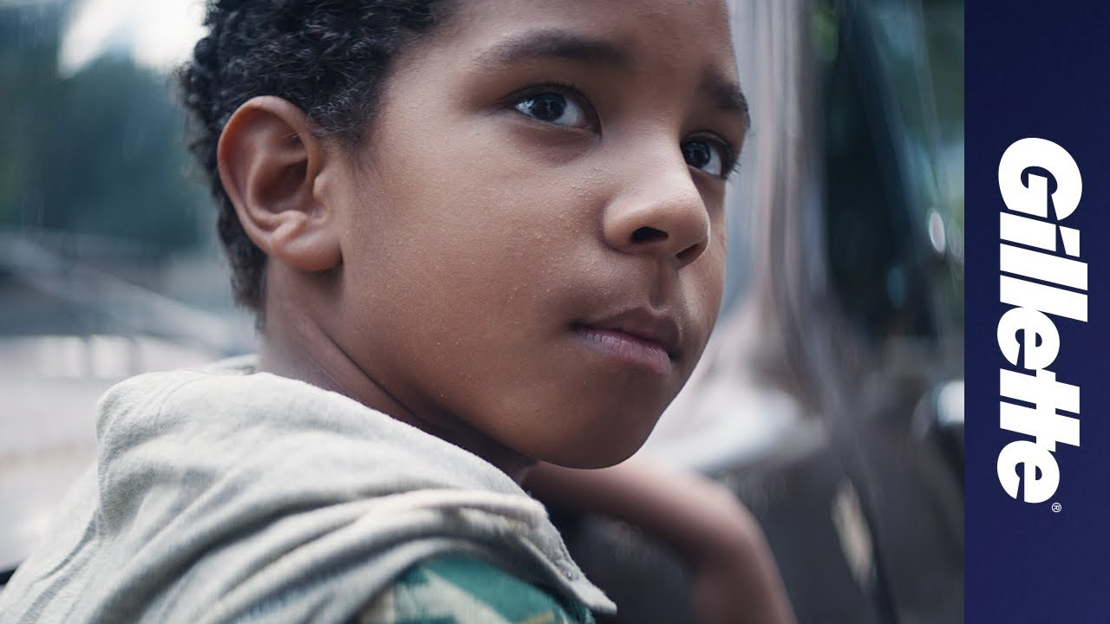

An Analysis of Two Twitter Campaigns
The Best A Man Can Be
January 14, 2019
The Joker Movie
September 2019

Slide 4
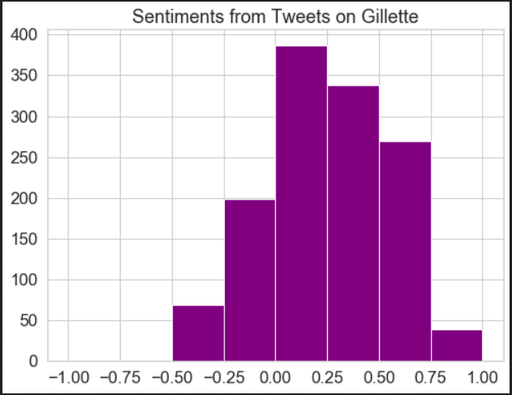
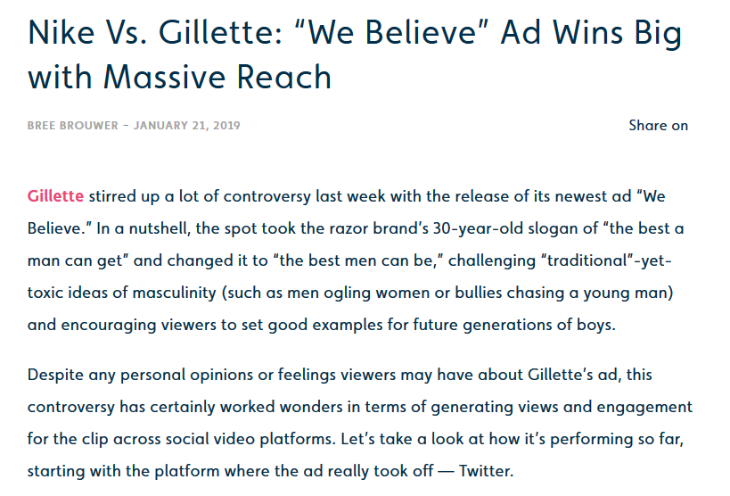
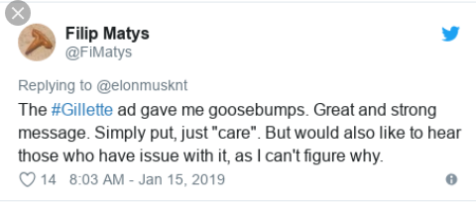
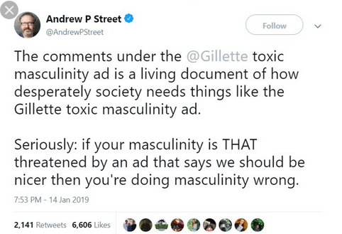
Twitter Sentiment Analysis: Gillette Ad
Sample size is a little over 3,800 Tweets.

Slide 5
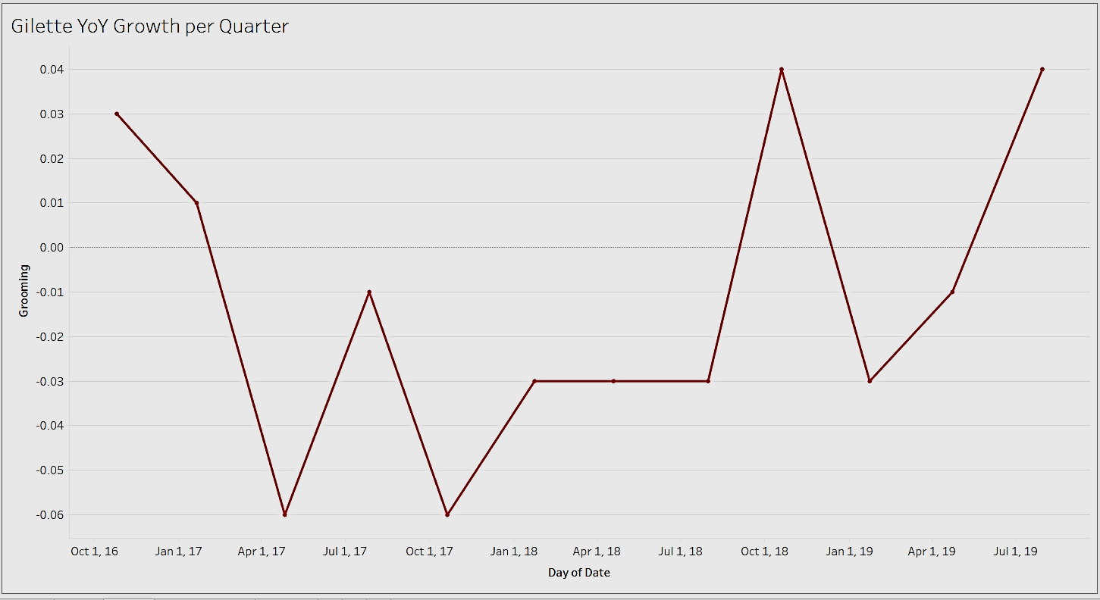
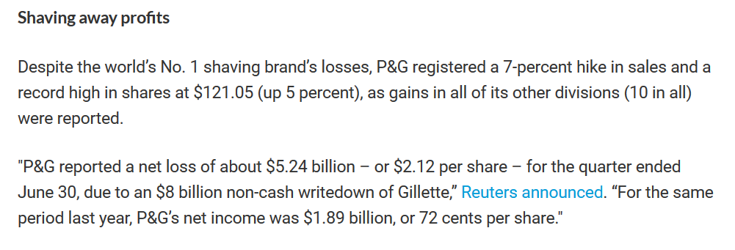
The Best A Man Can Be

Slide 6
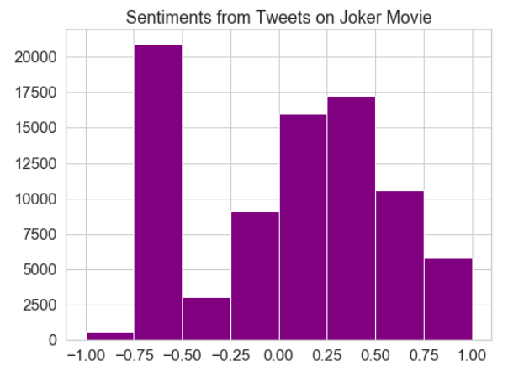
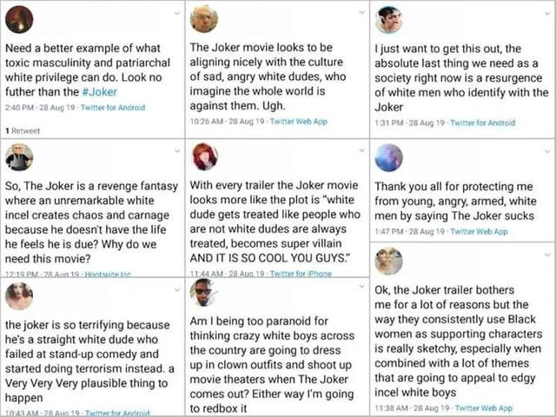
Twitter Sentiment Analysis: Joker Movie
I accidentally let my scraper run for 3 hours. I got 141,288 Tweets, which is a huge sample!

Slide 7
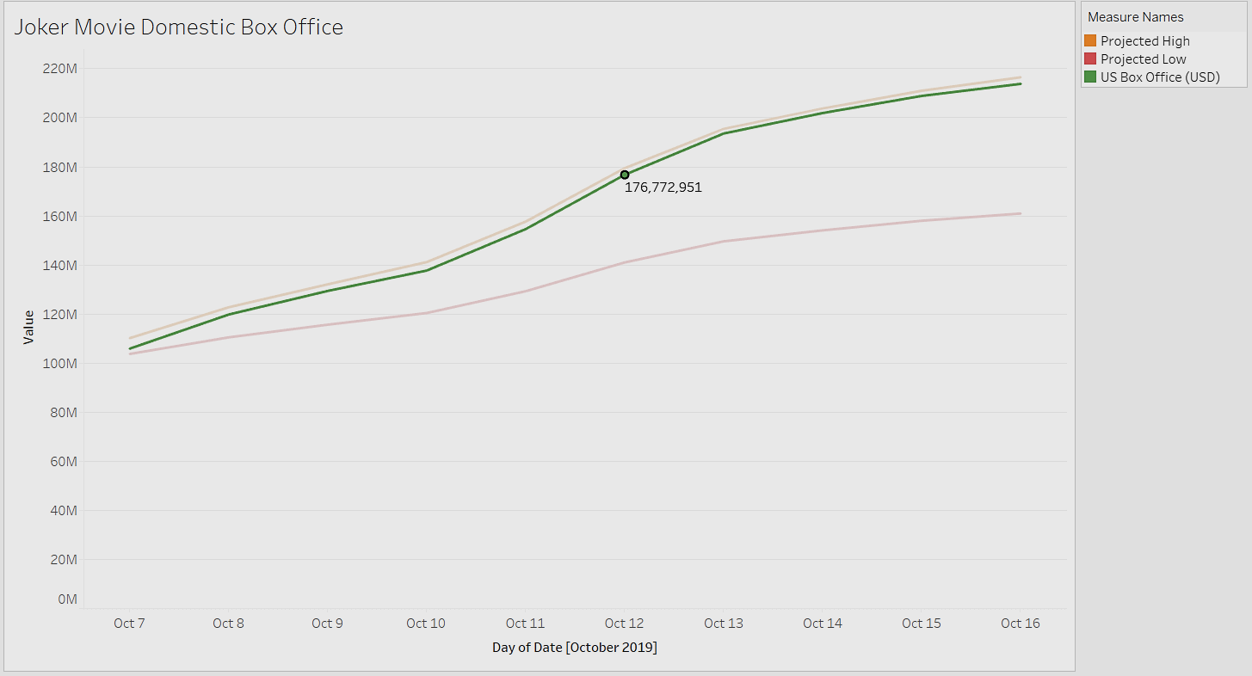

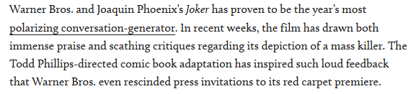

Slide 8

So, What Happened?

Slide 9
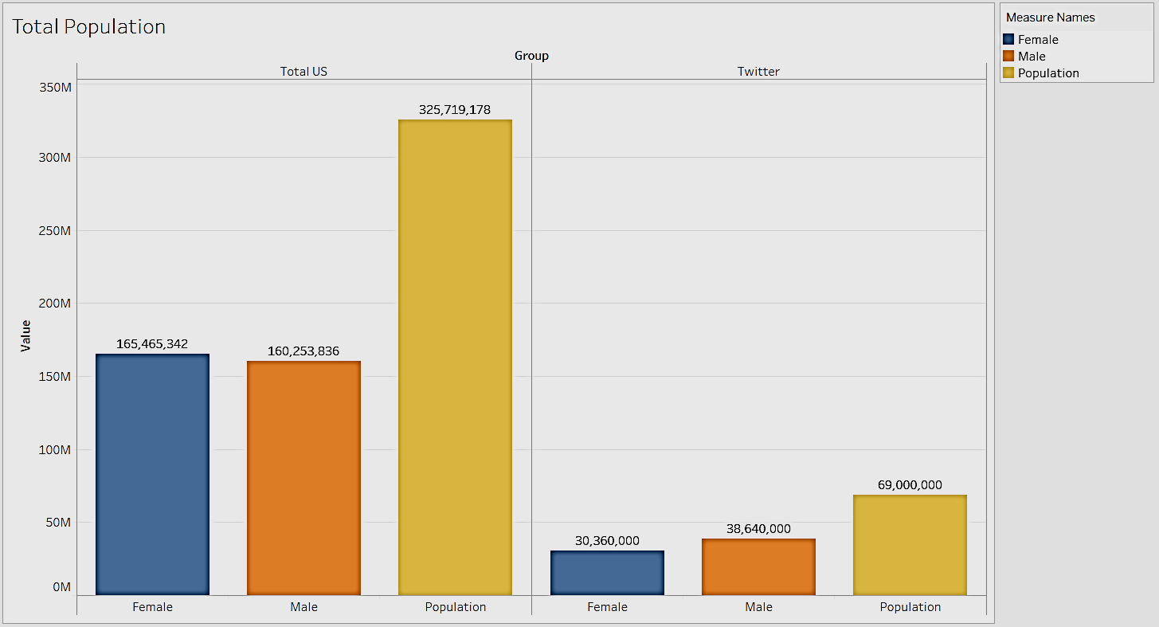
Who Does Twitter Represent?
US Population is ~326 M. and 21% of adults 18+ use Twitter.
Males are 49.2% of US population vs. 56% on Twitter.
Females are 50.1% of US population vs. 44% on Twitter.
This would lead us to believe that 24% of US Men and 18% of US Women can be reached!
Except…..

Slide 10
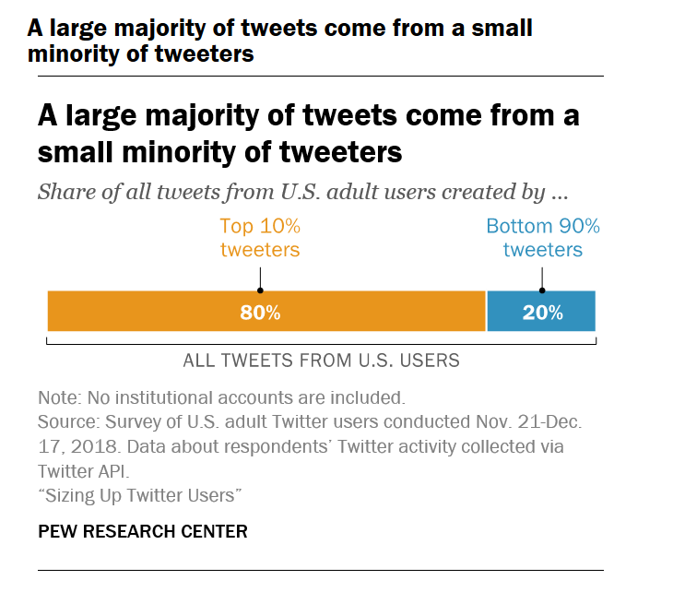
Oh…

Slide 11
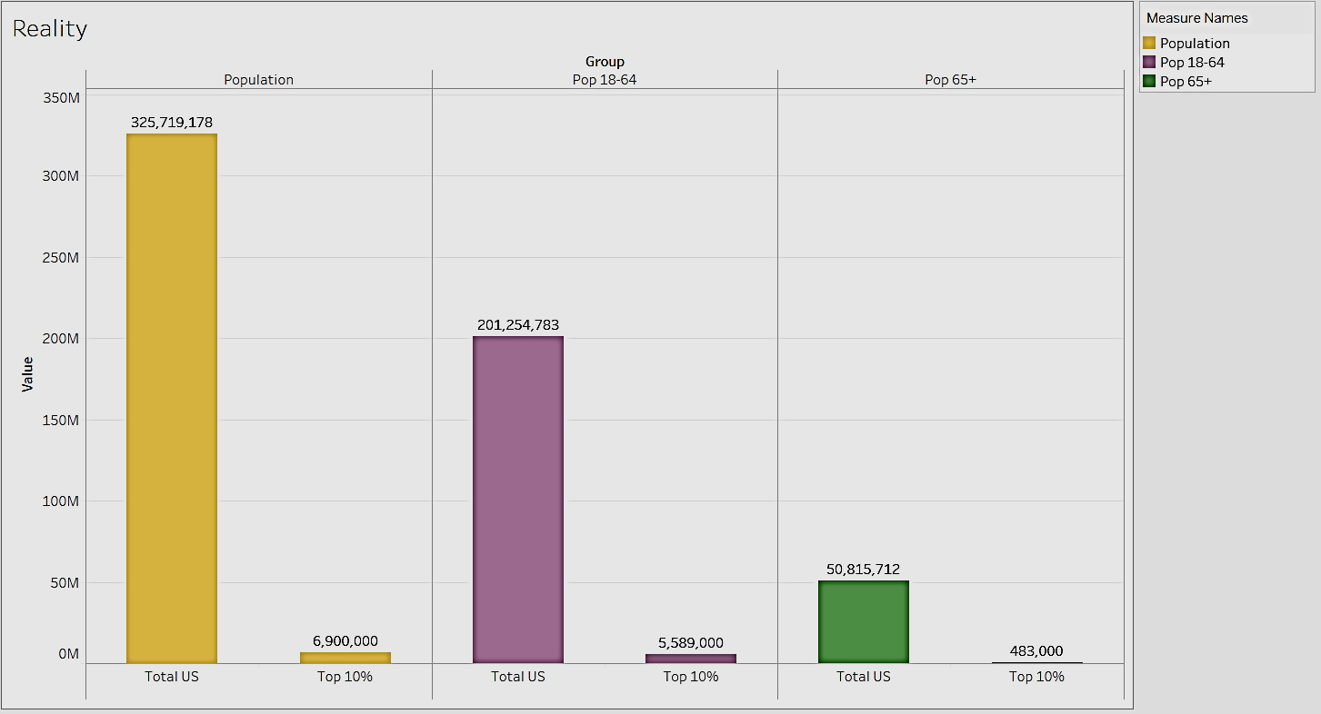
The Real Representation
2.12%
2.78%
0.95%

Slide 12
Final Thoughts
As we learn more about data collection and processing, we may be able to come up with better methods of assessing consumer response before catastrophic blunders are made.
There is nothing wrong with using social media as a metric, but designing a product or a campaign around the noisiest 2% of a population will alienate the other 98% of potential customers.
Further development: I am working on a YouTube scraper to perform similar analysis between comments, likes, dislikes and views. So far my ML algorithm is 98% able to predict if disabled comments negatively impact views.

